Slide 1
5G Ansible deployment - Zabbix

Slide 2

Project Goal
The goal of this project is to explore the use of containerization in the deployment of 5G networks and develop enhancements related to container health monitoring, automatic recovery and distributed loads

Slide 3





Tools used for the project: -
Ansible
Zabbix
Docker
Docker – Compose
Docker Swarm

Slide 4
Ansible
Ansible is a radically simple IT automation tool that simplifies the deployment of your apps and systems.
It support configuration management with examples as below.
Configuration of servers
Application deployment
Continuous testing of already install application
Provisioning
Orchestration
Automation of tasks

Slide 5
Why Ansible?
It is an open-source application that is available for free.
Agentless - There is no requirement for agent installation or management.
Based on Python/YAML
System configuration management that is highly versatile.
Myriad of ready-to-use system management components
If necessary, custom modules can be introduced.
In the event of an error, the configuration can be rolled back.
Straightforward and easy to read
Self documenting

Slide 6
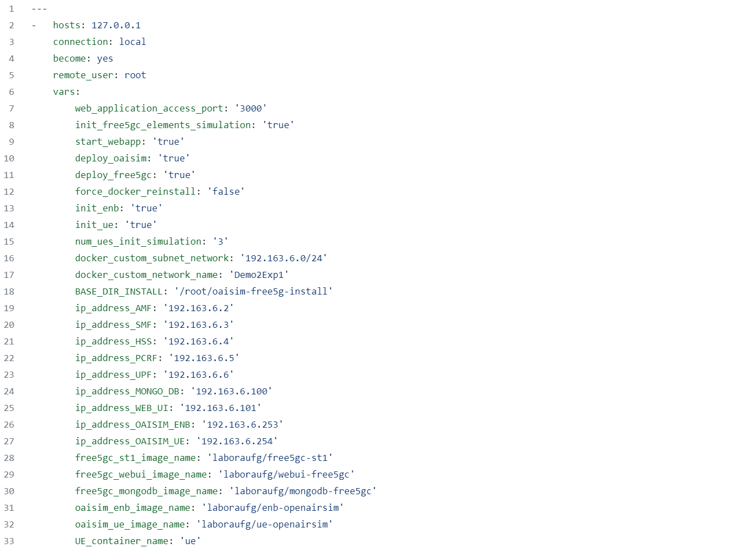
Example of YAML Script:-

Slide 7
Zabbix
Zabbix is an open-source software tool to monitor IT infrastructure such as networks, servers, virtual machines, and cloud services. Zabbix collects and displays metrics.
Zabbix offers excellent reporting and data visualization features based on the stored data
Zabbix is also able to perform actions such as sending notifications or perform recovery actions based on the data it collects

Slide 8
Overview of Docker tools used
Docker: Docker is a software platform that allows you to build, test, and deploy applications quickly. Docker packages software into standardized units called containers that have everything the software needs to run including libraries, system tools, code, and runtime
Docker compose: Docker Compose is a tool that was developed to help define and share multi-container applications. With Compose, we can create a YAML file to define the services and with a single command, can spin everything up or tear it all down
Docker Swarm: Docker Swarm is a clustering and scheduling tool for Docker containers. With Swarm, IT administrators and developers can establish and manage a cluster of Docker nodes as a single virtual system

Slide 9


Project
Demonstration

Slide 10
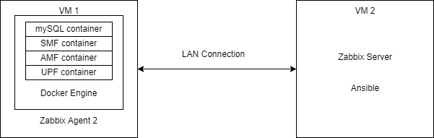
Scenario/Use Case 1 – Container Recovery
Local VM 1 running 5G core network function containers
Local VM 2 running Zabbix server – monitoring operation of docker containers on VM 1
Scenario: If containers were to stop running on VM 1:
Zabbix Server will detect change in container status
Zabbix Server will run Ansible Playbook that will then SSH into VM 1 and run command to restart containers – the command to restart containers is a docker-compose command
Zabbix Server will detect that containers have resumed operation

Slide 11
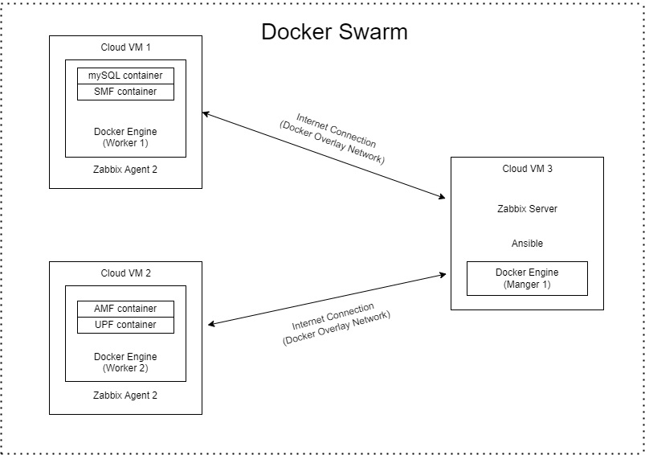
Scenario/Use Case 2 – Distributed Load
Three Cloud VMs included in Docker Swarm (1 manger, 2 workers)
Scenario: We can deploy all core network functions on the node closest to users, but what can we do if load at edge node becomes too much?
We can move network functions that are not impacted by latency to a different edge node further away from the user while keeping network functions that will be impacted by latency close to them

Slide 12

Thank You

